Slide 1

Sensitivity Analysis
MTH 564 – Mathematical Modeling

Slide 2

Sensitivity Analysis
Modeling
In the modeling process we make assumptions about the problem.
Data is obtained by measurement, observation and sometimes a guess.
We need to consider the validity and/or accuracy of the assumptions and data.
Sensitivity Analysis is the process of determining how changes in the assumption of a model impact the output or conclusion of the mathematical model.
Sensitivity Analysis is an important aspect of the modeling process.

Slide 3
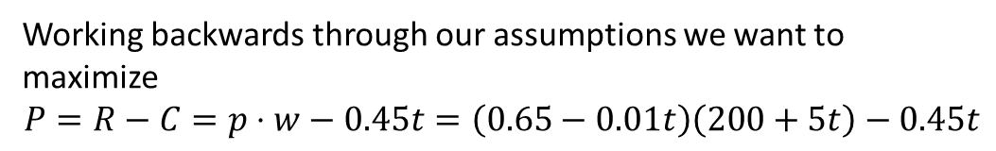
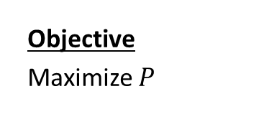
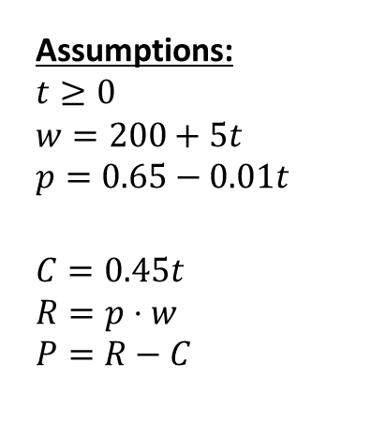
From Last Time
Variables:
t – time (in days)
w – weight of pig (lbs.)
p – price for pigs ($/lb.)
C – cost of keeping pig
R – revenue obtained by selling the pig
P – profit
Assumptions:
$$t≥0$$
$$w=200+5t \\ p=0.65−0.01t$$
$$C=0.45t \\ R=p⋅w \\ P=R−C$$
Objective
Maximize $P$
Constants (Measurements):
200 – starting weight of pig
5 – rate of change of pig’s weights
$0.45 – cost per day
$0.65 – price per pound
$0.01 – amount the price decreases per day
Working backwards through our assumptions we want to maximize
$$P=R−C=p⋅w−0.45t=\left(0.65−0.01t\right)\left(200+5t\right)−0.45t$$
If a measurement for one of our constant’s is wrong or it changes, how much does that affect our solution of t = 8 with a profit of $133.20?

Slide 4
Measurements
Constants (Measurements):
200 – starting weight of pig
5 – rate of change of pig’s weight
$0.45 – cost per day
$0.65 – price per pound
$0.01 – amount the price decreases per day
Of these measurements, which are prone to inaccuracy?
The weight of the pig, the cost it takes to maintain the pig, and the current price per pound should be easily measurable.
However, the amount the price changes per day is difficult to measure.
Also, the rate of change of the pig’s weight is somewhat out of our control.

Slide 5
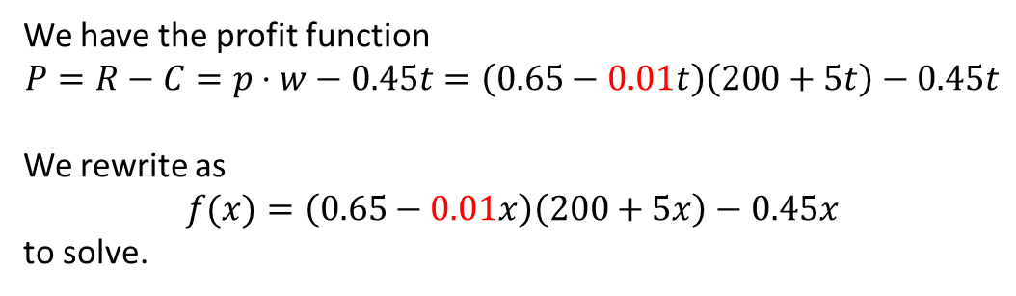
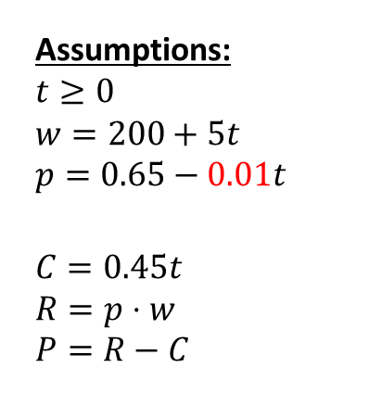
Rate of Price Change
Variables:
t – time (in days)
w – weight of pig (lbs.)
p – price for pigs ($/lb.)
C – cost of keeping pig
R – revenue obtained by selling the pig
P – profit
Assumptions:
$$t≥0$$
$$w=200+5t \\ p=0.65−0.01t$$
$$C=0.45t \\ R=p⋅w \\ P=R−C$$
Objective
Maximize $P$
Constants (Measurements):
200 – starting weight of pig
5 – rate of change of pig’s weights
$0.45 – cost per day
$0.65 – price per pound
$0.01 – amount the price decreases per day
We have the profit function
$$P=R−C=p⋅w−0.45t=\left(0.65−0.01t\right)\left(200+5t\right)−0.45t$$
We rewrite as
$$f(x)=\left(0.65−0.01x\right)\left(200+5x\right)−0.45x$$
to solve.

Slide 6
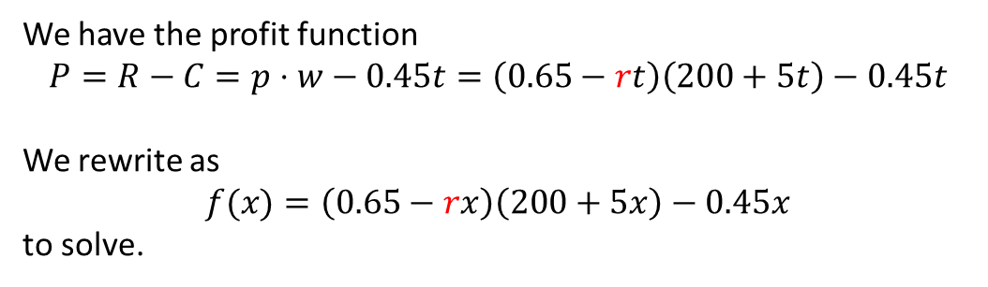
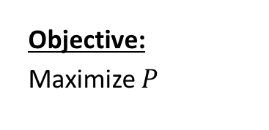
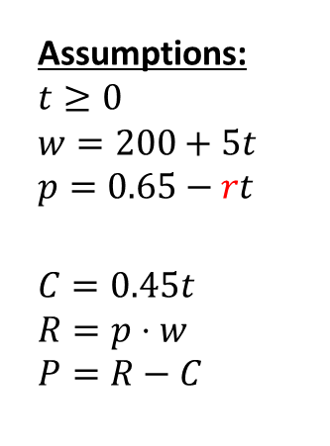
Rate of Price Change: Introduce Parameter r
Variables:
t – time (in days)
w – weight of pig (lbs.)
p – price for pigs ($/lb.)
C – cost of keeping pig
R – revenue obtained by selling the pig
P – profit
Assumptions:
$$t≥0$$
$$w=200+5t \\ p=0.65−rt$$
$$C=0.45t \\ R=p⋅w \\ P=R−C$$
Constants (Measurements):
200 – starting weight of pig
5 – rate of change of pig’s weights
$0.45 – cost per day
$0.65 – price per pound
Objective:
Maximize $P$
Parameter:
r – amount the price decreases per day
We have the profit function
$$P=R−C=p⋅w−0.45t=\left(0.65−rt\right)\left(200+5t\right)−0.45t$$
We rewrite as
$$f(x)=\left(0.65−rx\right)\left(200+5x\right)−0.45x$$
to solve.

Slide 7
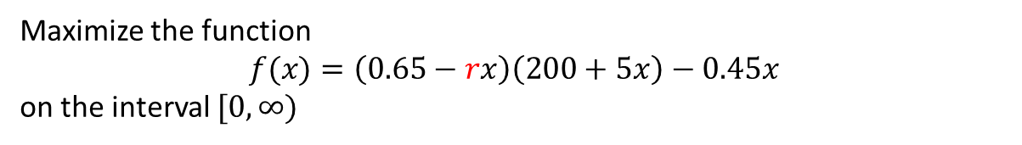
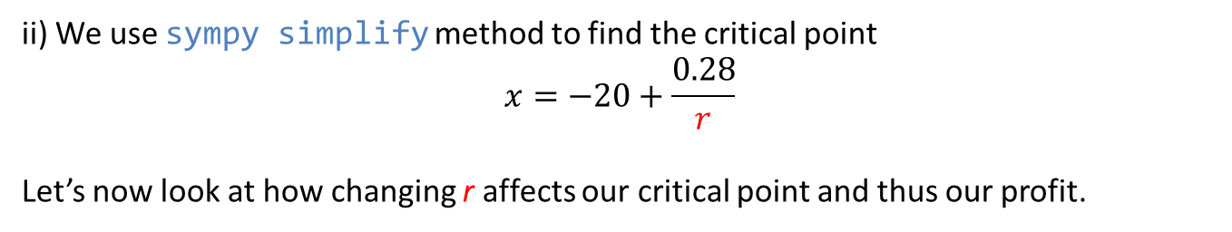
Example: Selling a Pig
Maximize the function
$$f(x)=\left(0.65−rx\right)\left(200+5x\right)−0.45x$$
on the interval $[0,∞)$
The maximum will occur at a critical point or an endpoint of the interval.
i) We now use sympy diff function in python to find the derivative
$$f^{′}\left(x\right)=−10rx−200r+2.8$$
ii) We use sympy simplify method to find the critical point
$$x=−20+\frac{0.28}{r}$$
Let’s now look at how changing r affects our critical point and thus our profit.
Python File: section1-2-sensitivity-r

Slide 8
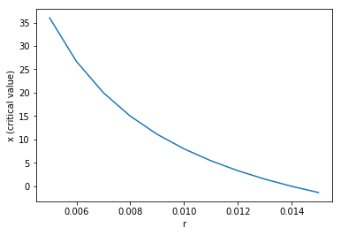
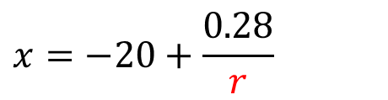
Rate of Price Change (r) versus Time (x)
r | x
0.005 | 36.0
0.006 | 26.667
0.007 | 20.0
0.008 | 15.0
0.009 | 11.111
0.010 | 8.0
0.011 | 5.455
0.012 | 3.333
0.013 | 1.538
0.014 | 0.0
0.015 | -1.333
$$x=−20+\frac{0.28}{r}$$
Notes:
New Python Commands
Lambdify
Arange
Round
subplot

Slide 9
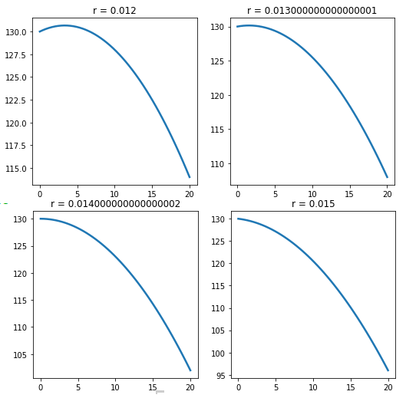
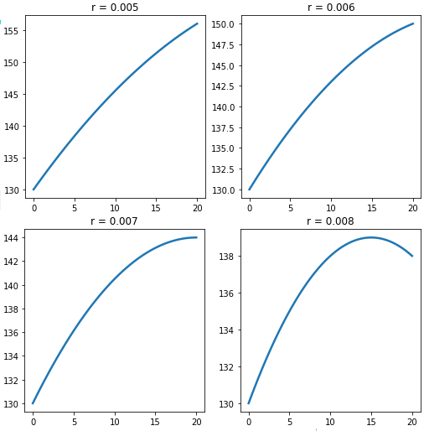
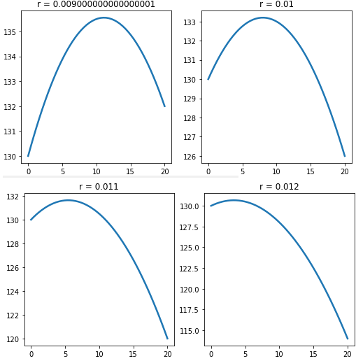
Graphs of Profit for different values of r
r | x
0.005 | 36.0
0.006 | 26.667
0.007 | 20.0
0.008 | 15.0
0.009 | 11.111
0.010 | 8.0
0.011 | 5.455
0.012 | 3.333
0.013 | 1.538
0.014 | 0.0
0.015 | -1.333
Notes:
New Python Commands
Lambdify
Arange
Round
subplot

Slide 10
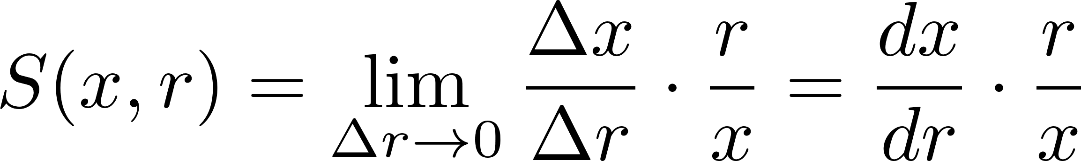
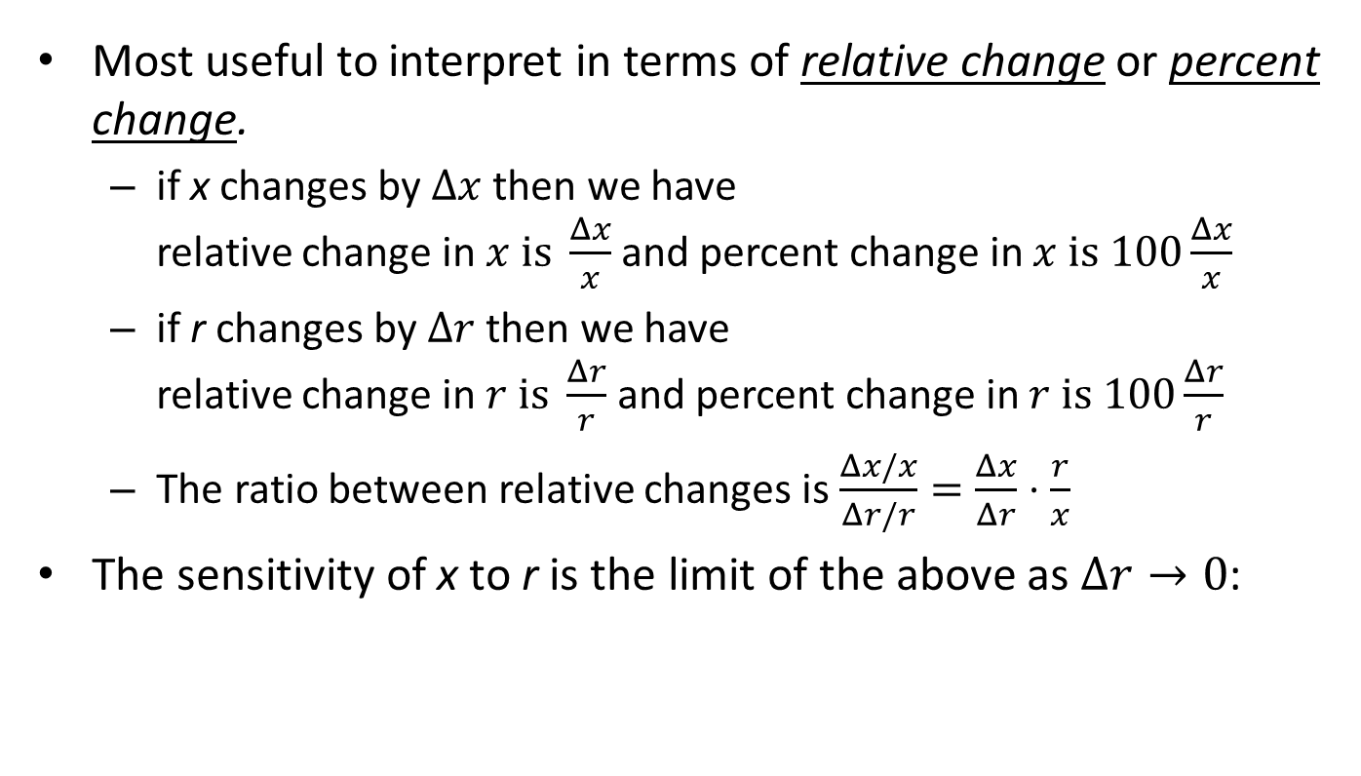
Sensitivity of x to r
Most useful to interpret in terms of relative change or percent change.
if x changes by $Δx$ then we have relative change in $x is \frac{Δx}{x}$ and percent change in $x is 100\frac{Δx}{x}$
if r changes by $Δr$ then we have relative change in $r is \frac{Δr}{r}$ and percent change in $r is 100\frac{Δr}{r}$
The ratio between relative changes is $\frac{Δx/x}{Δr/r}=\frac{Δx}{Δr}⋅\frac{r}{x}$
The sensitivity of x to r is the limit of the above as $Δr→0$:

Slide 11
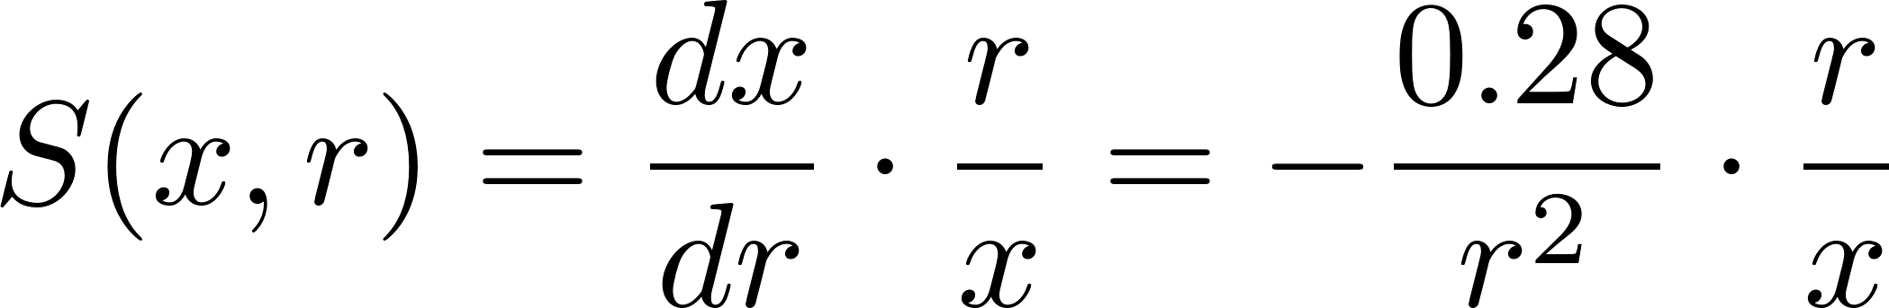
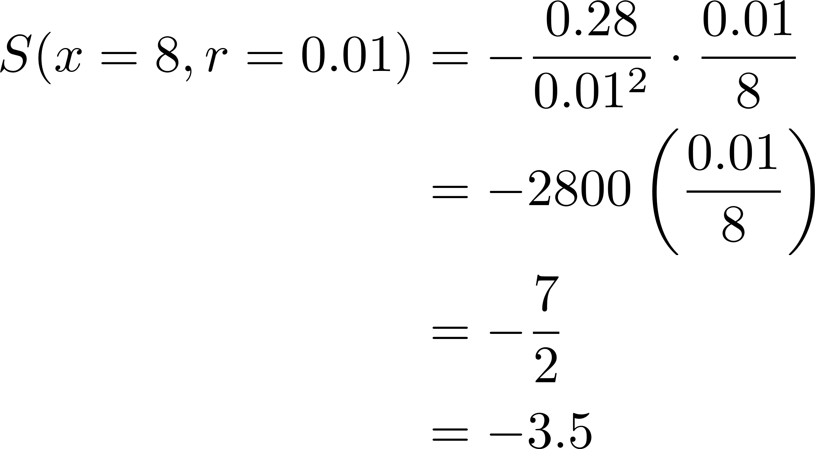

Sensitivity of x to r
Our definition of S(x,r) with $x=−20+\frac{0.28}{r}$ gives us
So, in this particular example we have r = 0.01 and x = 8. Thus the sensitivity of x to r at this point is given by

Slide 12
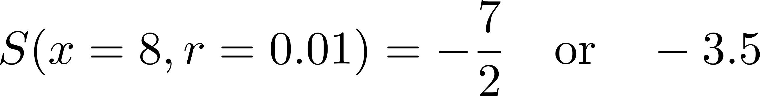
Interpretation of S(x,r)
From the previous slide we
There are several valid ways to interpret this:
If r goes up 2%, then x goes down 7%.
If r goes up 1%, then x goes down 3.5%.
If r goes up 10%, then x goes down 35%.
How do we communicate this back to the customer/business?
If the rate at which the price is falling goes up at 2% then we would need to sell the pig about 7% earlier.
Notes:
If the rate at which the price is falling goes up at 2% then we would need to sell the pig about 7% earlier.

Slide 13
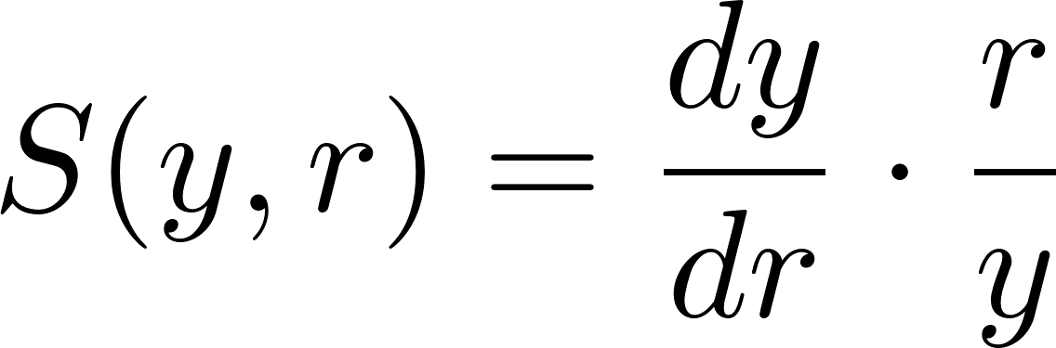
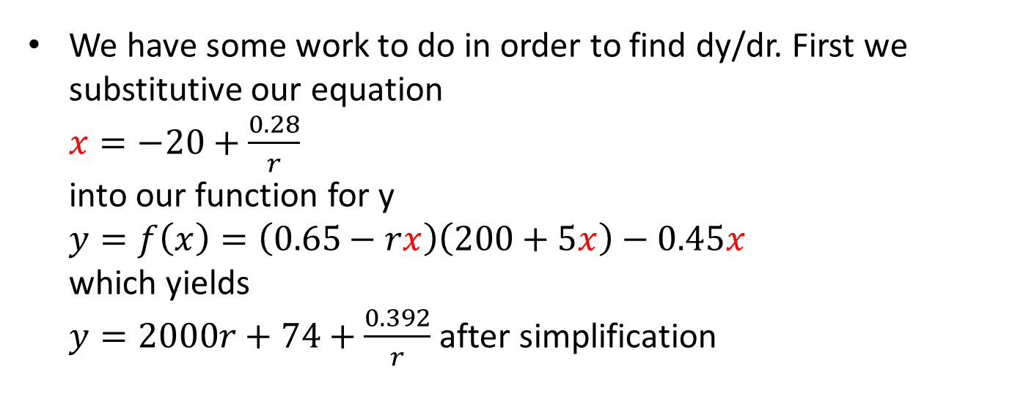
Sensitivity of y (Profit) to r
Recall the definition S(y,r):
We have some work to do in order to find dy/dr. First we substitutive our equation $x=−20+\frac{0.28}{r}$ into our function for y $y=f\left(x\right)=\left(0.65−rx\right)\left(200+5x\right)−0.45x$ which yields $y=2000r+74+\frac{0.392}{r}$ after simplification
Notes:
See python code (simplify)

Slide 14
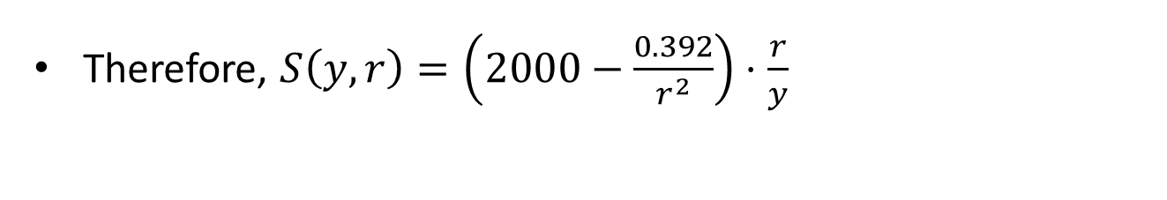

Sensitivity of y (Profit) to r
Recall the definition S(y,r):
So we have
$$y=2000r+74+\frac{0.392}{r}$$
which gives us a derivative of $$\frac{dy}{dr}=2000−\frac{0.392}{r^{2}}$$
Therefore, $S\left(y,r\right)=\left(2000−\frac{0.392}{r^{2}}\right)⋅\frac{r}{y}$
Notes:
See python code (simplify)

Slide 15
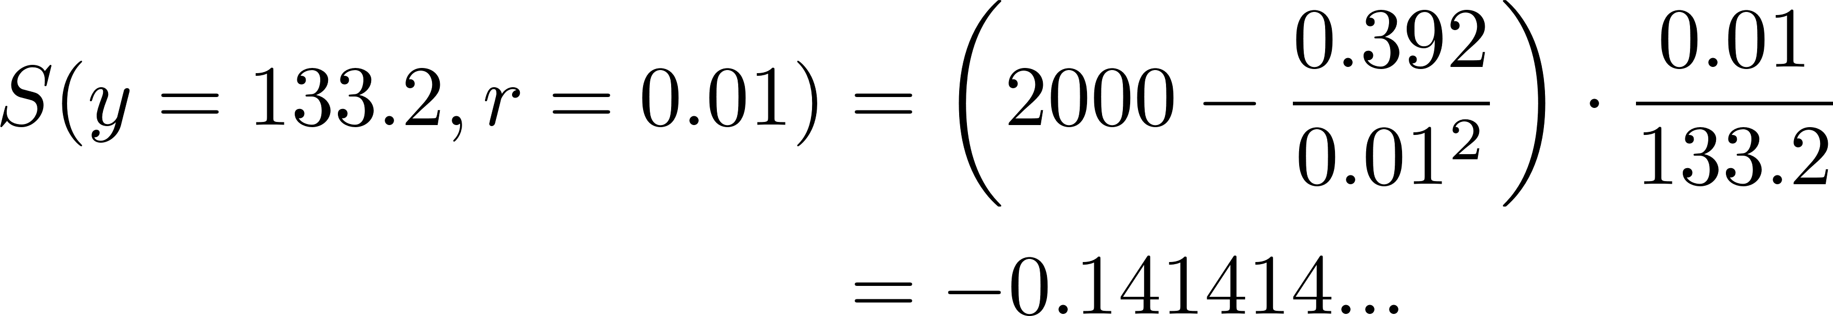
Sensitivity of y (Profit) to r
In our example we have r = 0.01 and y = 133.20. Thus the sensitivity of y to r at these values is given by
Interpretation: If the rate at which the price is decreasing rises 10%, then the expected profit will go down roughly 14%.
Notes:
See python code (simplify)

Slide 16
Sensitivity Analysis Summary
Application of sensitivity analysis requires (good) judgement
analysis does not need to be conducted for each parameter
select those parameters that have the most uncertainty
Interpretation depends on degree of uncertainty about the parameter
In the pig problem we are probably more certain about the growth rate g than the rate r at which prices fall.
A 25% error in g would be surprising, but a 25% error in r would not be all that surprising.
Notes:
Time permitting continue with the sensitivity analysis of g: section1-2-sensitivity-g.py

